Slide 1



UNIT 4
LESSON 15
Healthy and happy
Part 4

Slide 2
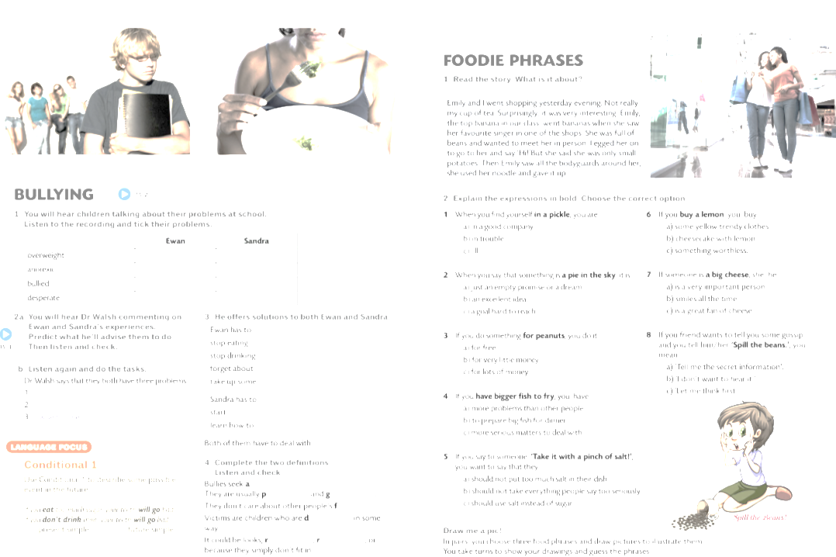

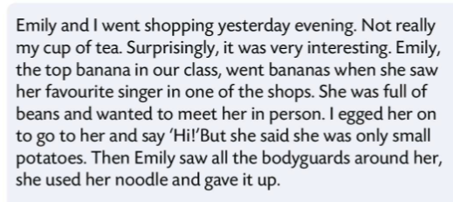
not my cup of tea = not interested
not really like top banana = the leader or boss
go bananas = go crazy a bit
full of beans = extremely happy and energetic
egg on someone = encourage someone
small potatoes = unimportant
her noodle = her brain

Slide 3

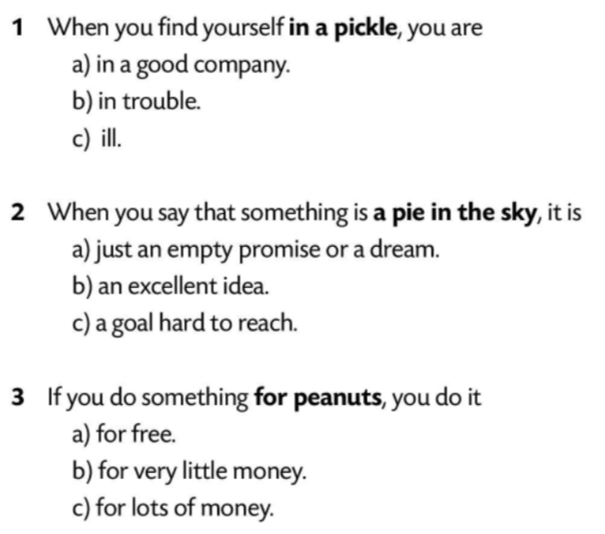
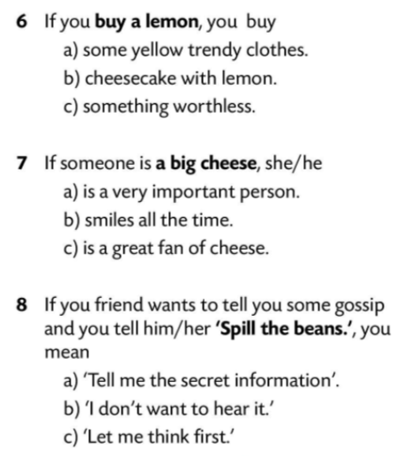
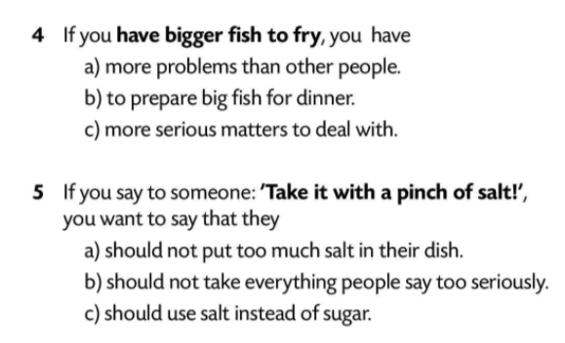

Slide 4
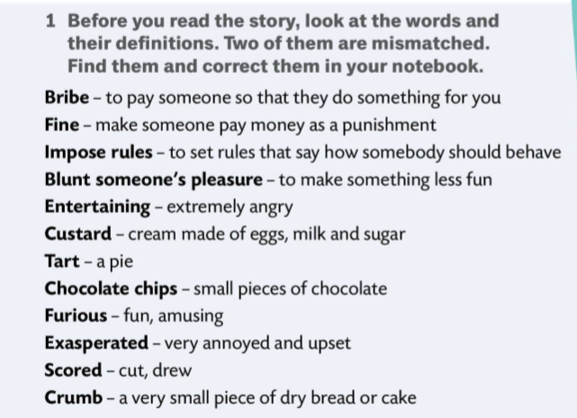

A She tried to bribe them with...
Draw me a pic!
B She sat them down in easy chairs in front of the television and...
Are you out of your mind?
What’s wrong with you?
C Finally, furious with herself, she...
magazine, doctor, chocolate, in the wood, daughter, pocket money, pizza, advice, mother
entertaining - fun, amusing;
furious - extremely angry

Slide 5
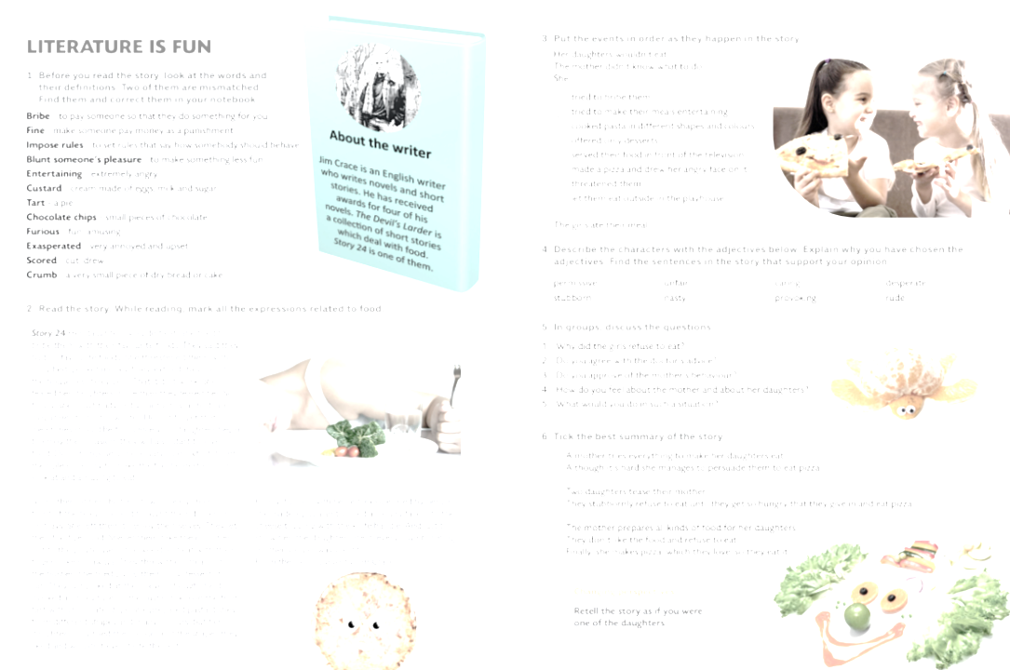
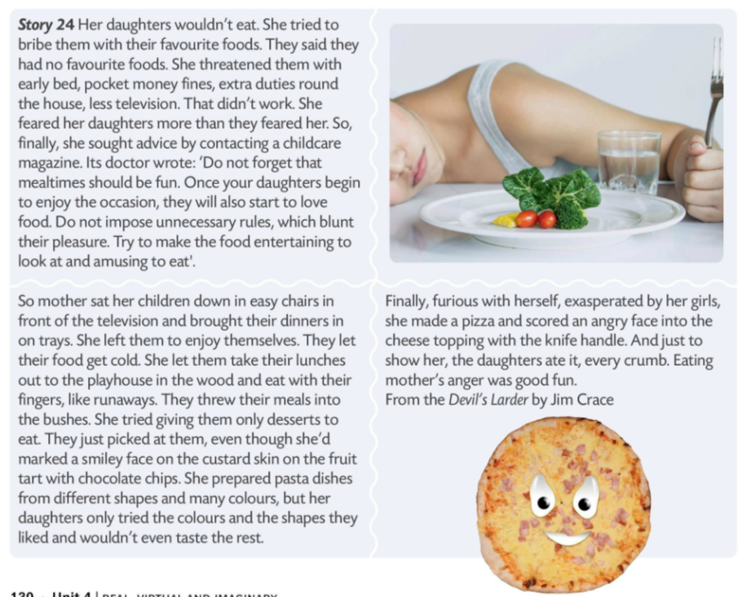
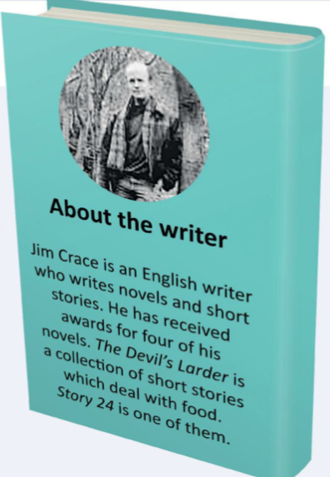

Slide 6
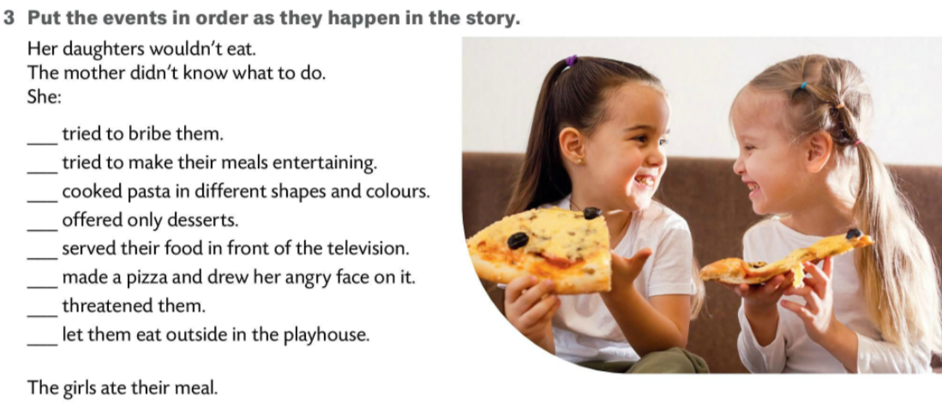
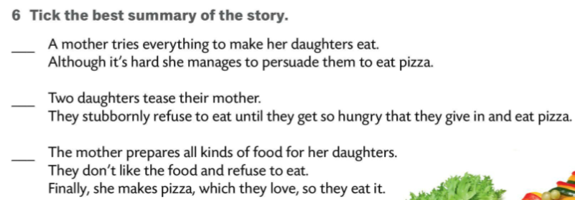
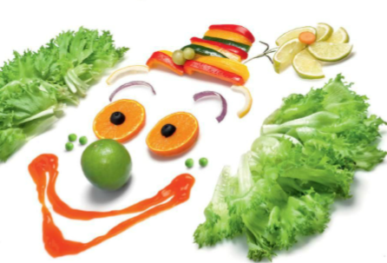

1
3
7
6
4
8
2
5

Slide 7
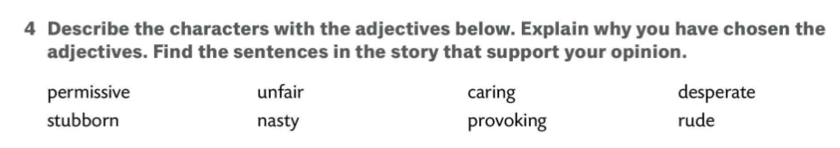
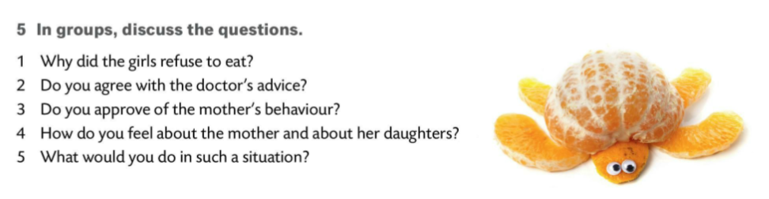
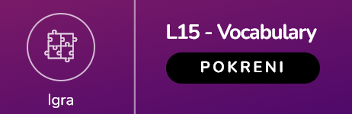
popustljiv
nepošten
brižan
beznadan
tvrdoglav
svojevoljan
provocirajući
neuljudan

